Slide 1
DOOR LOCK USING PASSKEY
Objective: a chip that unlocks a door only when the correct 8-digit code is entered. If the user enters the sequence correctly, the door unlocks. If a wrong digit is entered, the system resets and starts over.

Slide 2
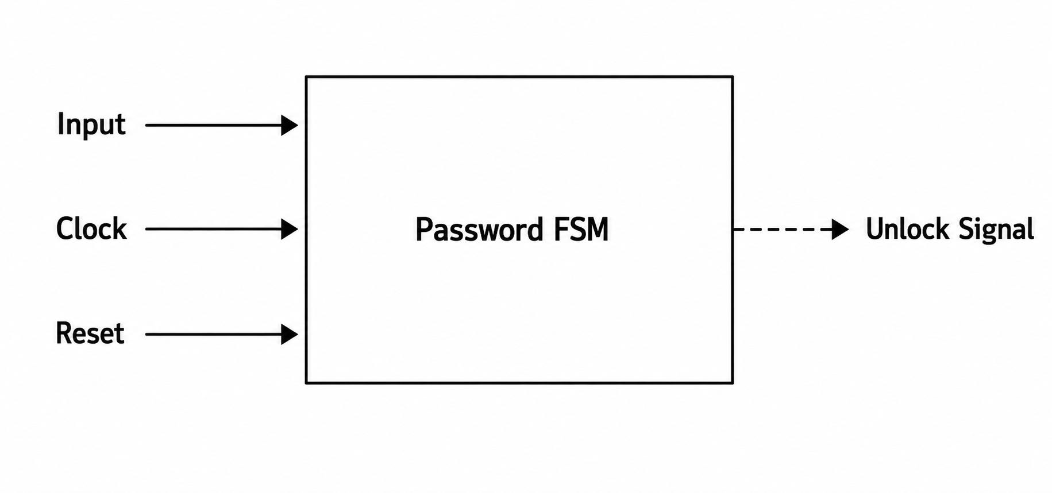
BLOCK DIAGRAM

Slide 3
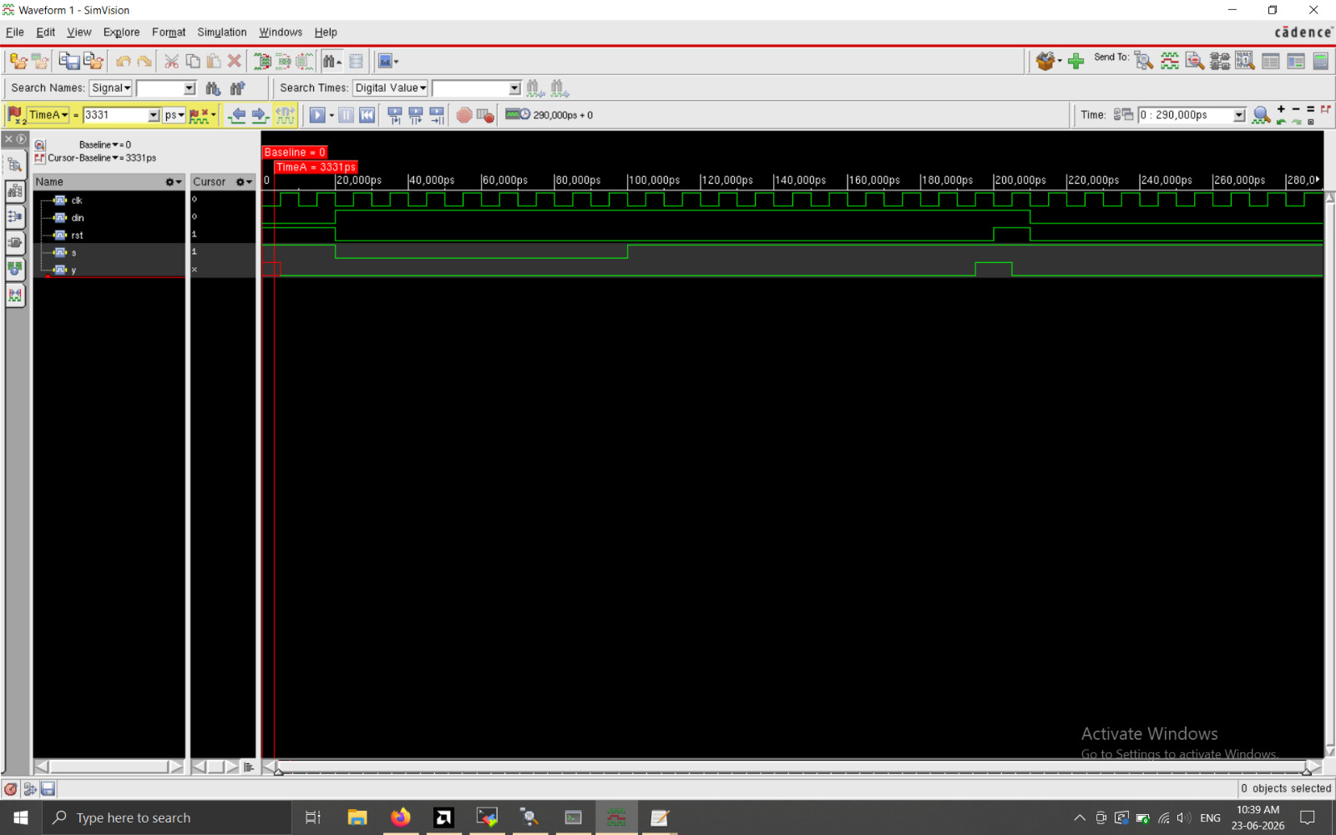
SIMULATION

Slide 4
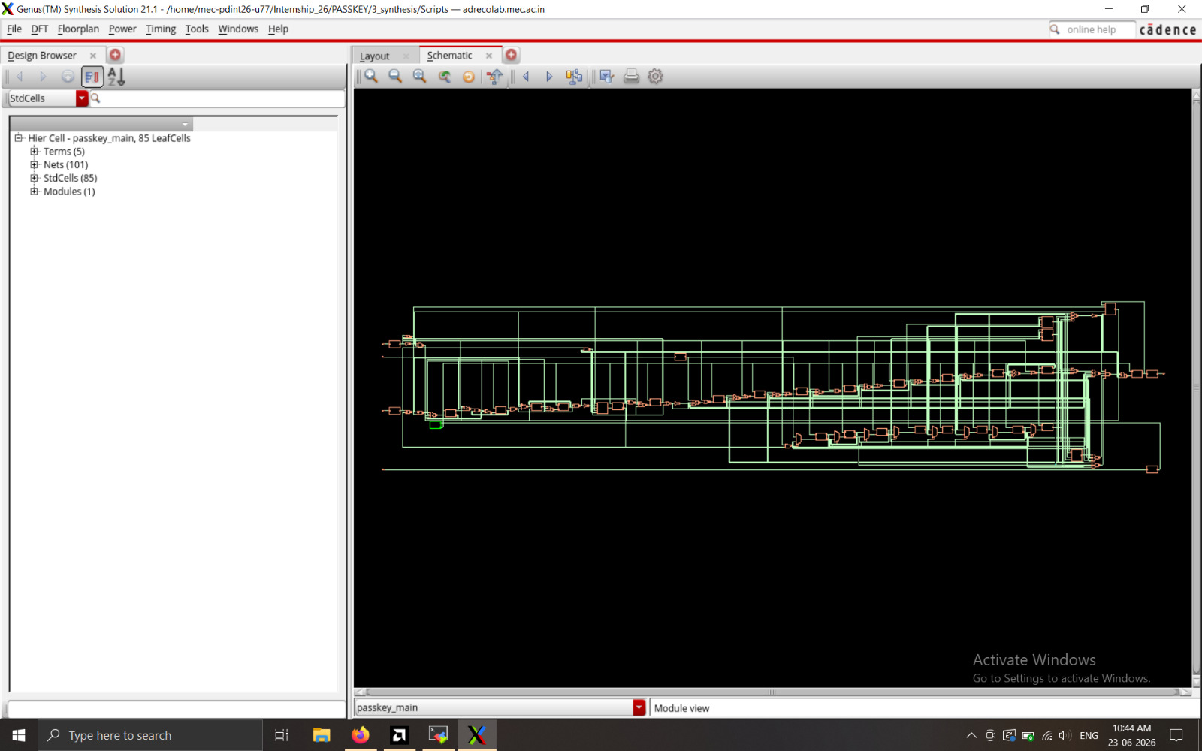
SYNTHESIS

Slide 5
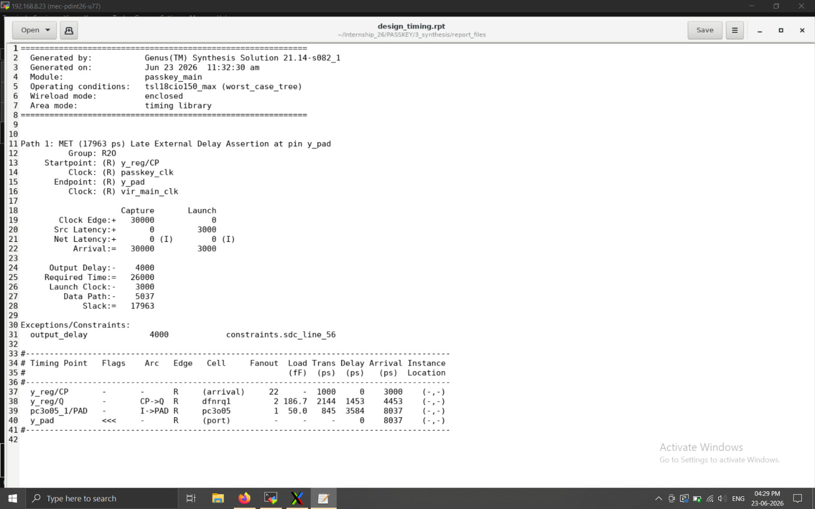
TIMING

Slide 6
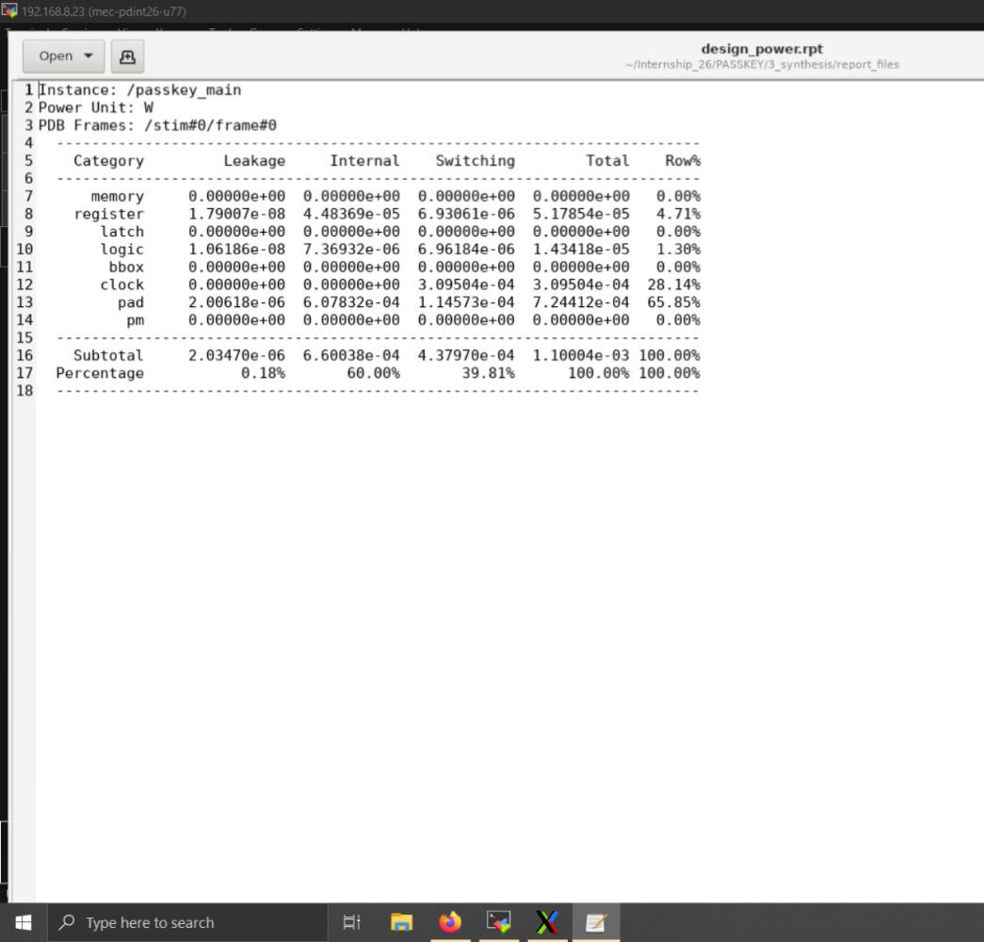
POWER

Slide 7
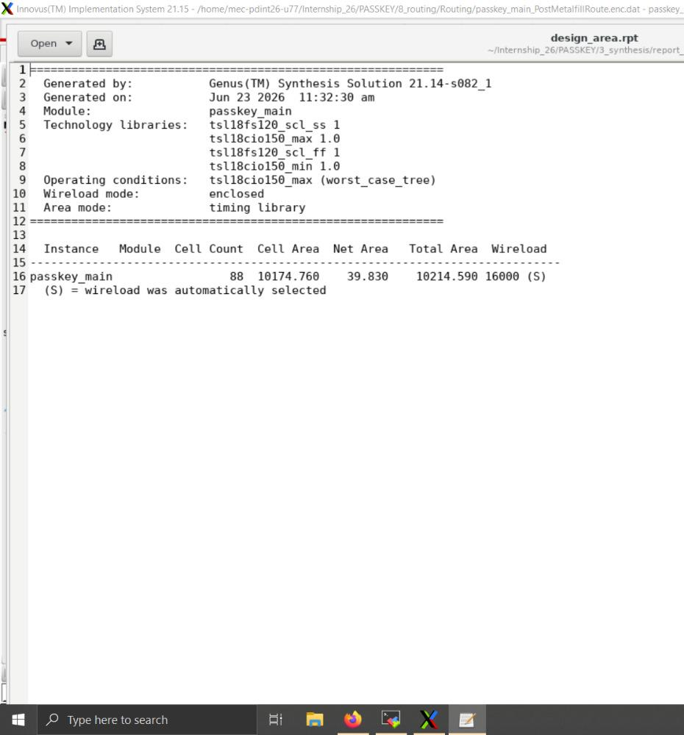
AREA

Slide 8
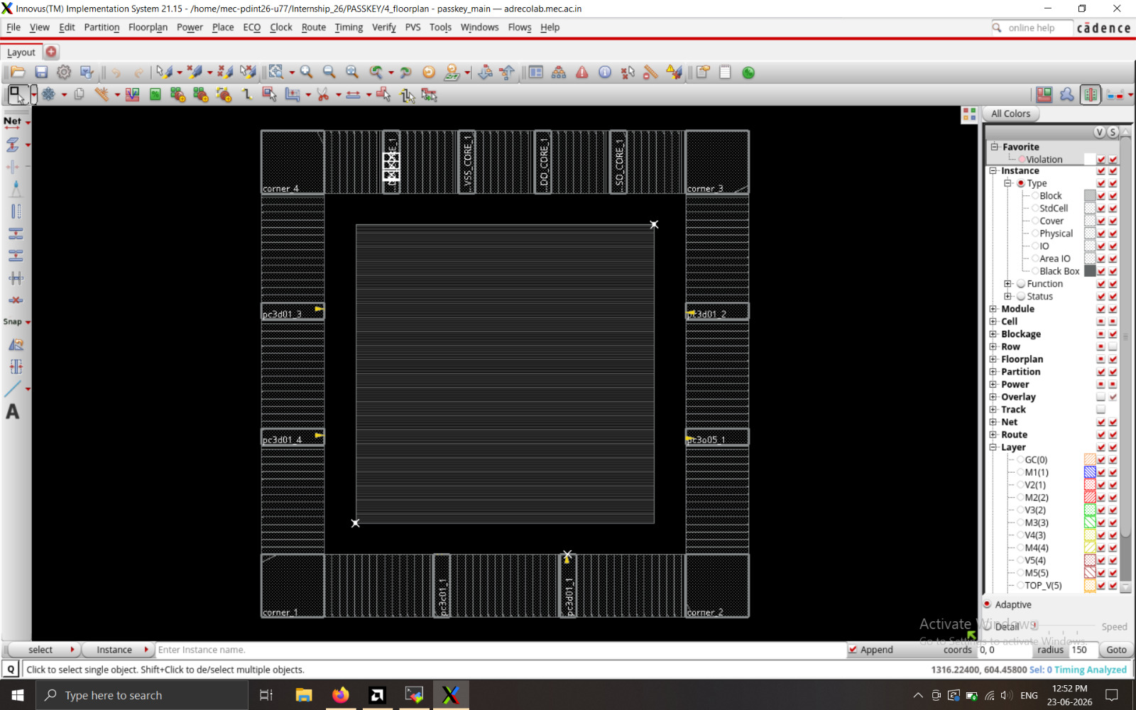
FLOOR- PLANNING

Slide 9
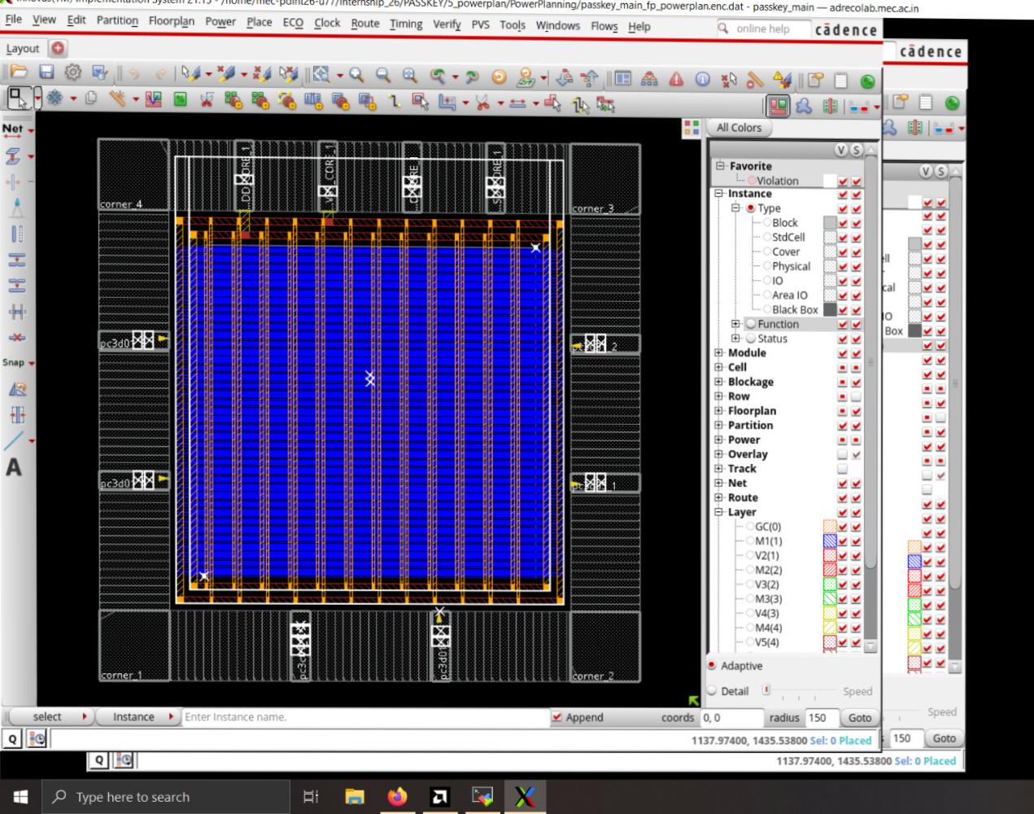
POWER-PLANNING

Slide 10
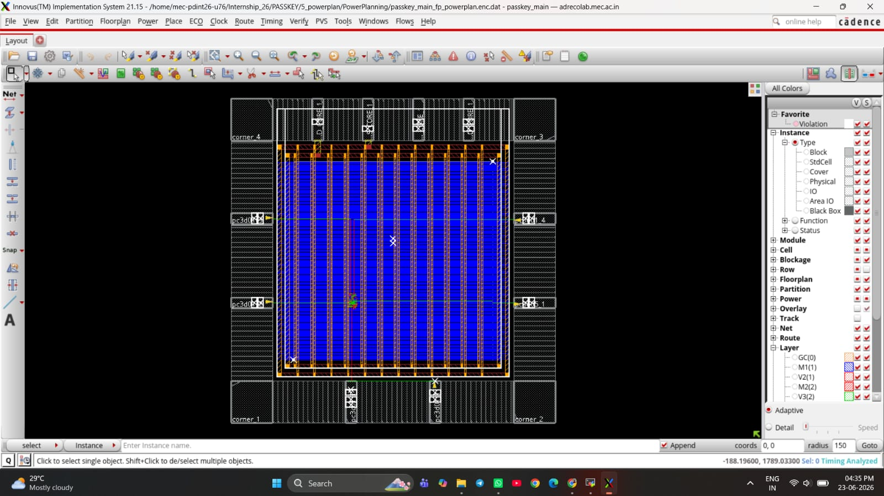
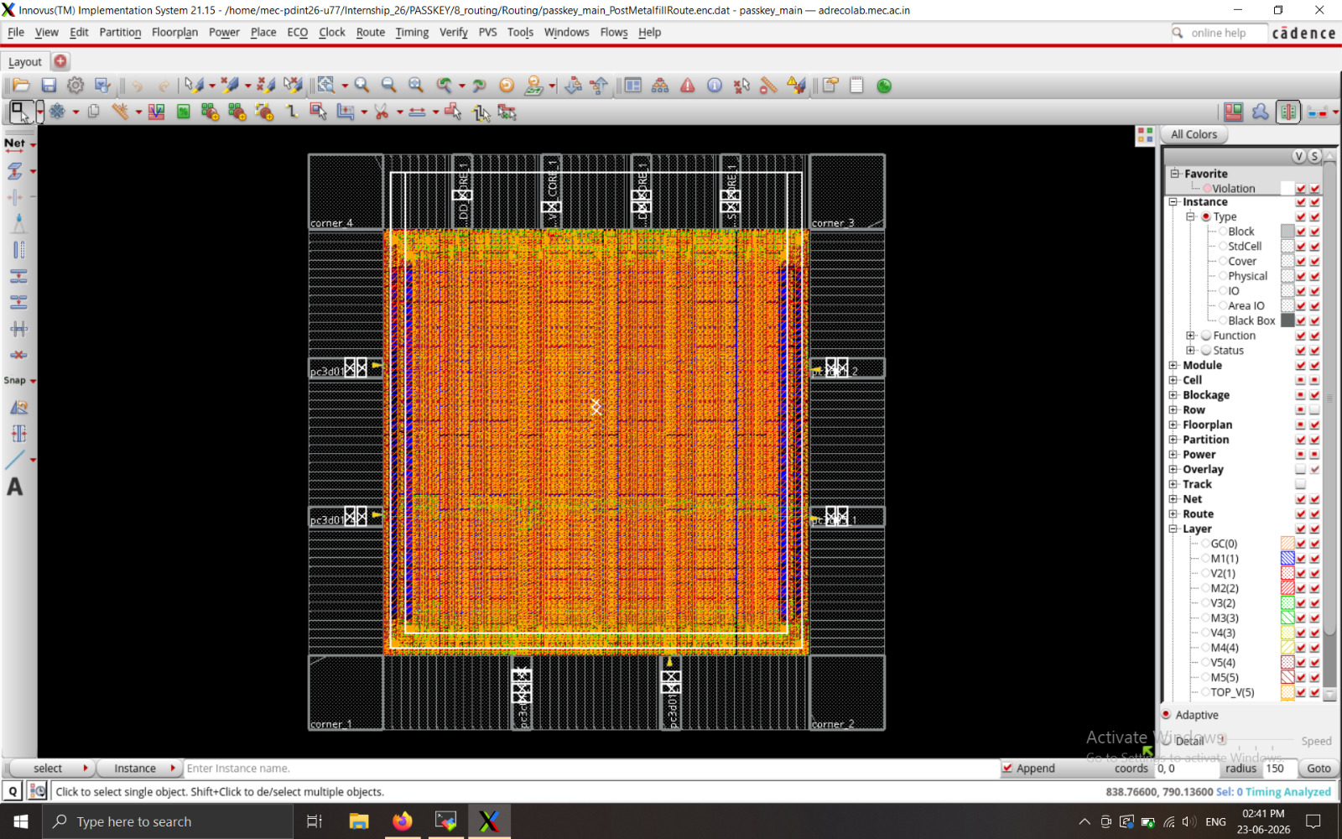
PLACEMENT

Slide 11
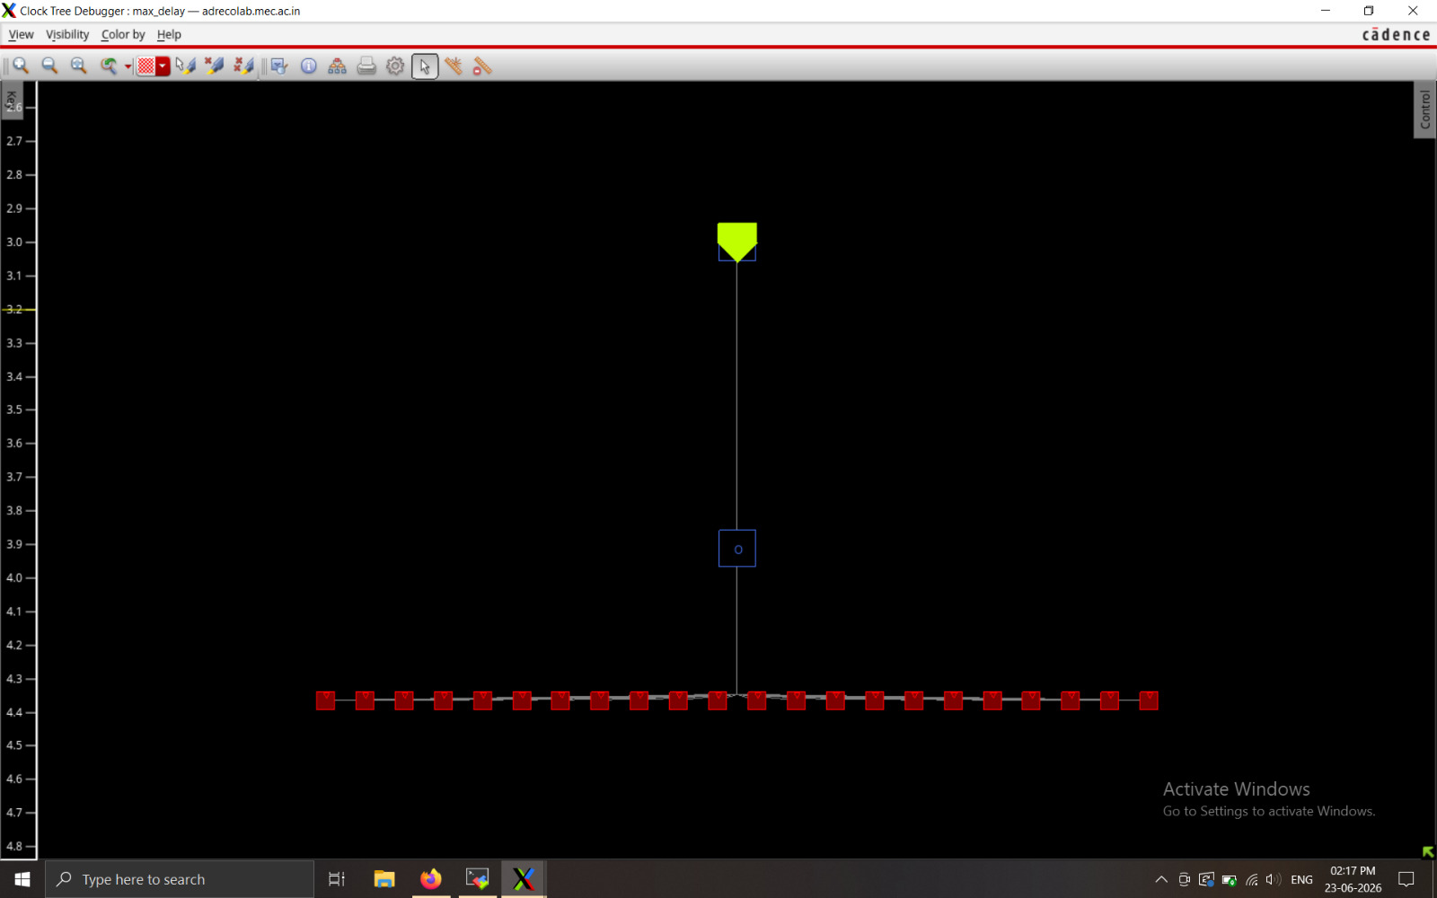
CLOCK

Slide 12

ROUTING

